Slide 1
From Barcelona to San Sebastian
1.Arrival the airport
2. Barcelona–El Prat Airport to Sants
https://goo.gl/maps/dZRdDDmDtrp
Subway R2N: Aeroport to Barcelona Sants
3.Renfe 西班牙高铁
BARCELONA-SANTS to San Sebastian/Donostia
https://venta.renfe.com/vol/search.do?c=_vvoJ
出发时间 | 到达时间 | 用时 | 火车 | 最低售价 | 舱位 | 税
7:30 | 13.03 | 5 h. 33 min. | ALVIA | 38,80 € | Turista | Promo
10:05 | 15.48 | 5 h. 43 min. | INTERCITY | 37,15 € | Turista | Promo
15:30 | 21.1 | 5 h. 40 min. | ALVIA | 38,80 € | Turista | Promo

Slide 2
San Sebastián
San Sebastián (Spanish: [san seβasˈtjan]) or Donostia (Basque: [doˈnos̺tia])^{[3]} is a coastal city and municipality located in the Basque Autonomous Community(巴斯克自治区) , Spain. It lies on the coast of the Bay of Biscay(比斯开湾), 20 km (12 miles) from the French border. The capital city of Gipuzkoa, the municipality's population is 186,095 as of 2015,^{[4]} with its metropolitan area reaching 436,500 in 2010.^{[5]} Locals call themselves donostiarra(singular), both in Spanish^{[6]} and Basque.
The main economic activities are commerce and tourism, and it is one of the most famous tourist destinations in Spain.^{[7]} Despite the city’s small size, events such as the San Sebastián International Film Festival have given it an international dimension. San Sebastián, along with Wrocław, Poland, was the European Capital of Culture in 2016.^{[8]}
插座转换器，自带插线板，电饭锅，电水壶，网线。
手机卡：orange

Slide 3
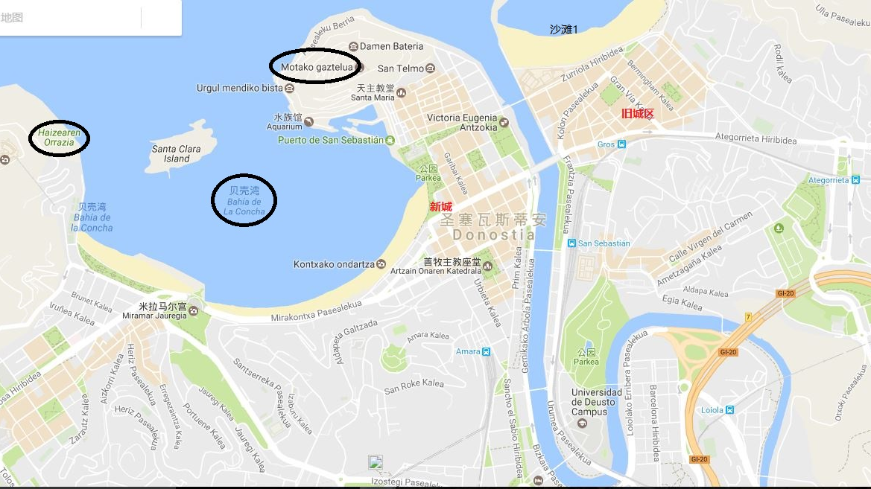
San Sebastian

Slide 4
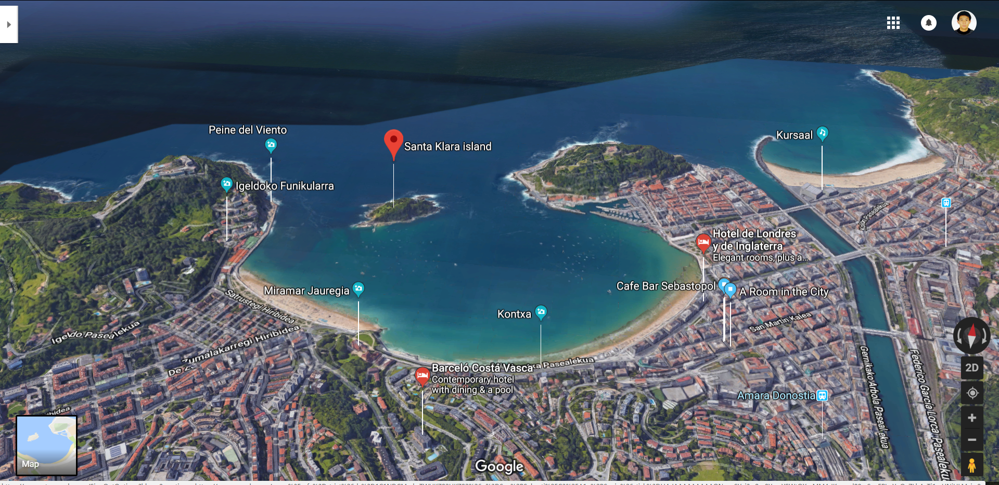
景点
The beach of La Concha 贝壳海滩
https://www.spain-holiday.com/San-Sebastian/articles/the-beach-of-la-concha-in-san-sebastian-a-beach-you-must-see
http://www.mafengwo.cn/i/7136786.html

Slide 5
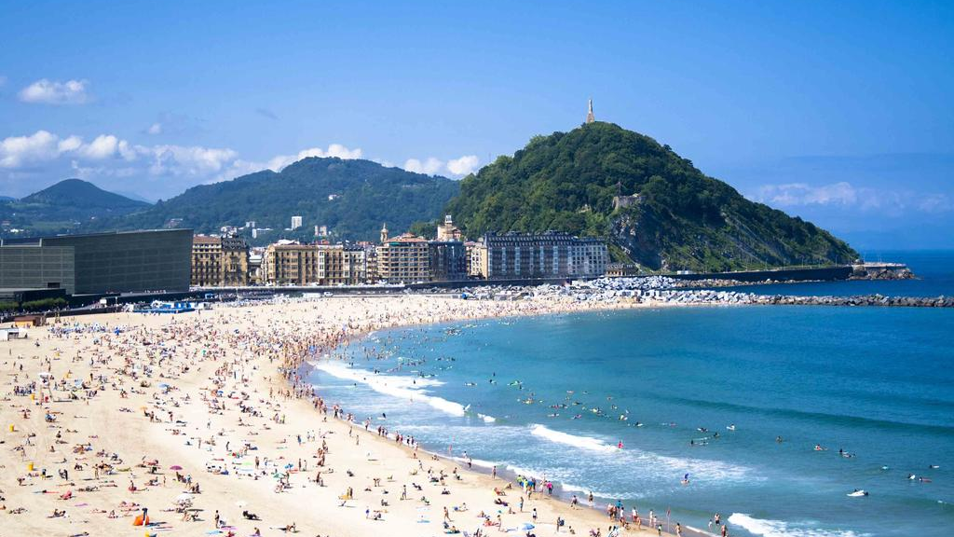
Zurriola hondartza
Watching Sunset
Near old town
Big spindrift
Most northern
Notes:
先说最北边的沙滩，这个是最壮观的，因为中间没有小岛阻挡潮水，因此这里的浪潮最汹涌，沙滩边缘都有石块围起来，据说涨潮的时候都会淹没。这里可以看日落，因为没有小岛挡住视线，这里也更靠近老城区。我生日那天，一个人来海边看日落，夕阳照在沙滩上，金黄金黄的色调，暖心得很。本想等着太阳下山，但是和实验室的小伙伴约了晚饭，当太阳还在海平面上的时候我就闪人了。

Slide 6
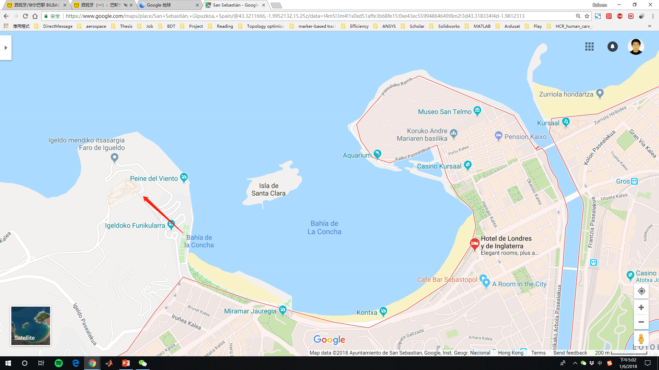
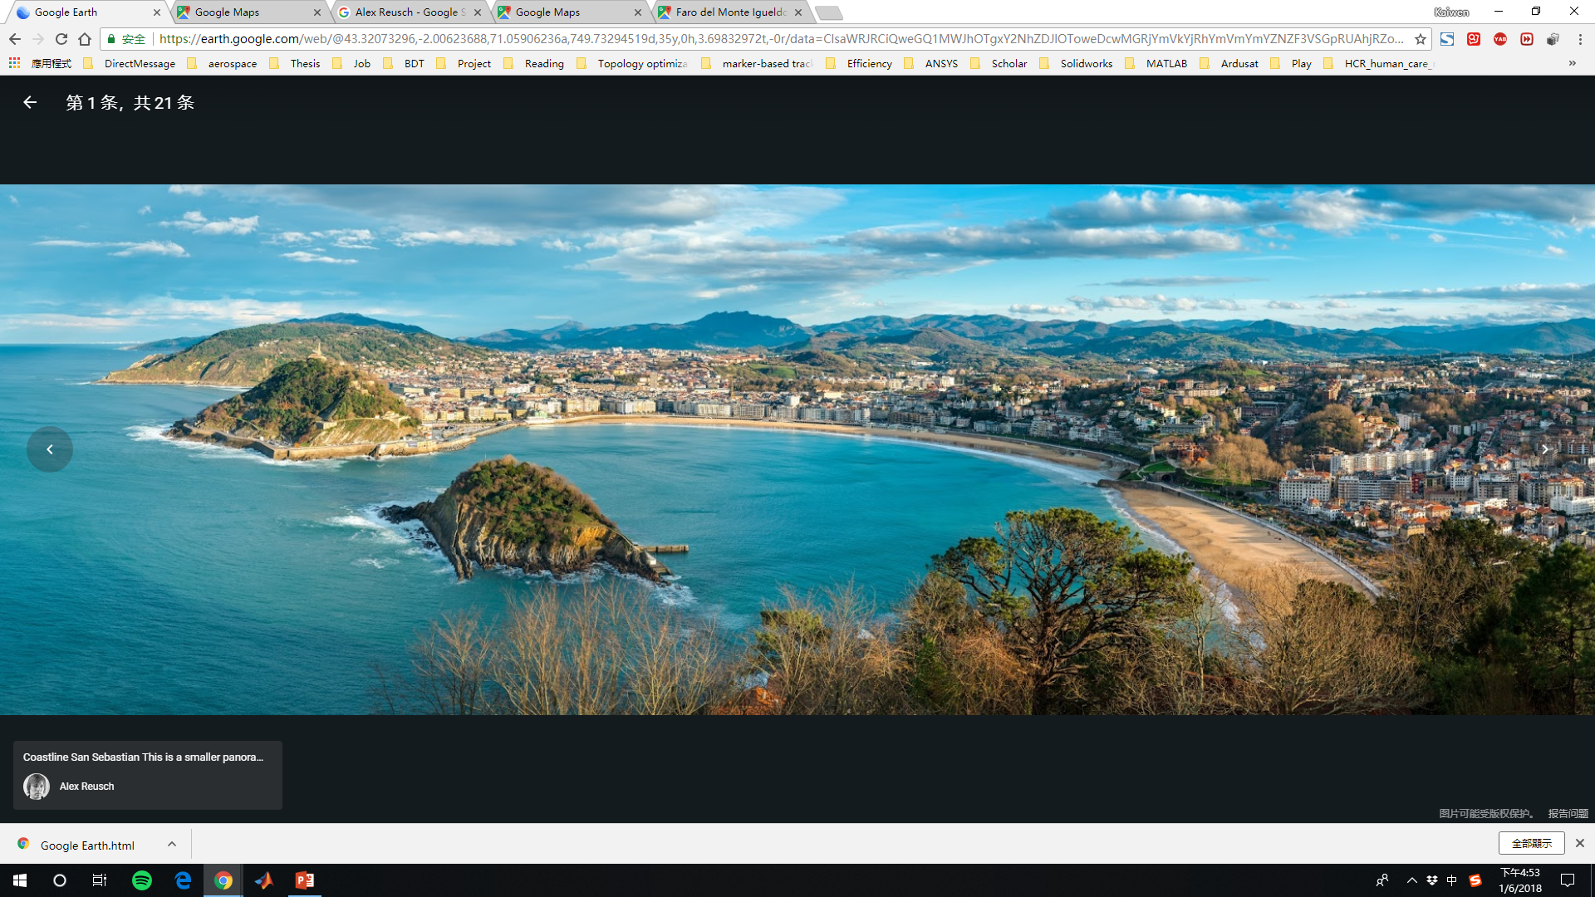
Top highest place in the beach of La Concha
Itsasargi
Parque de Atracciones Monte Igueldo
Hotel Mercure San Sebastian Monte Igueldo
Notes:
做小火车上山，门票3.25欧，上面是一个游乐场，可以看日落。

Slide 7
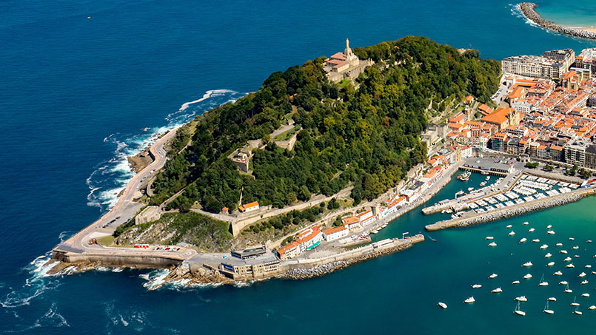
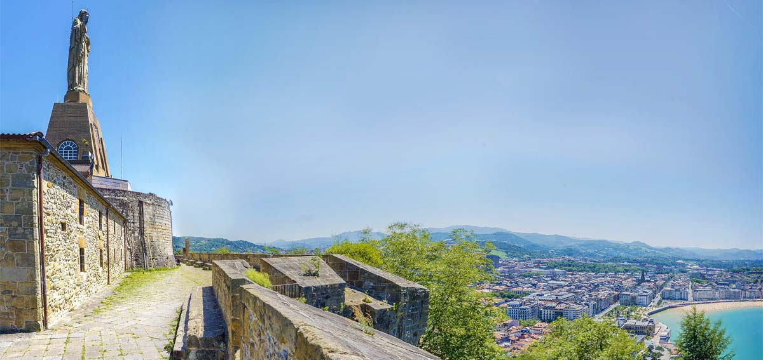
乌尔古尔山（Monte Urgull）
https://www.sansebastianturismo.com/en/to-do/what-not-to-miss/mount-urgull
Notes:
You can walk to the summit of Monte Urgull, topped by the low castle walls of the Castillo de la Mota and a grand statue of Christ, by taking a path from Plaza de Zuloaga or from behind the aquarium. The views are breathtaking and the shady parkland on the way up is a peaceful retreat from the city.

Slide 8
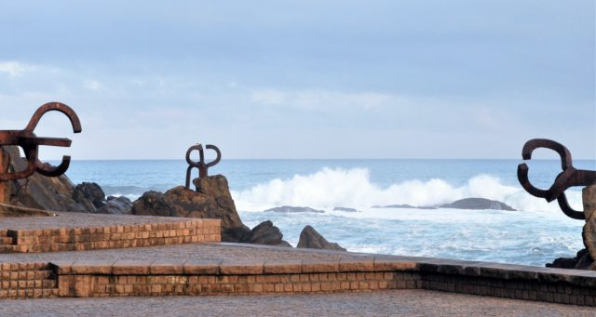
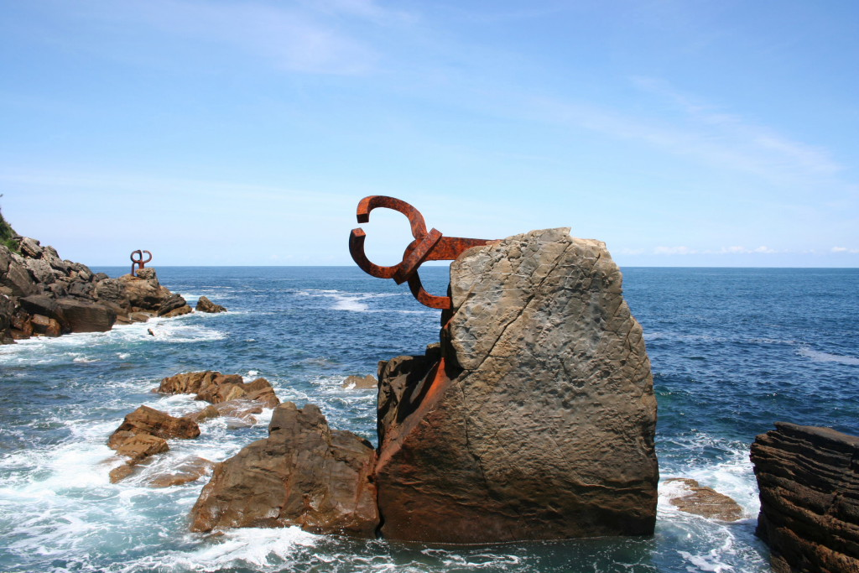
Peine Del Viento 风之梳
钢铁雕塑《风之梳》是西班牙雕塑家爱德华多·奇利达（1924～2002）于1977年完工的室外雕塑作品。他用条形锻铁作为创作用材组合成三个钢铁雕塑，一个垂直竖立在近海的巨石上，两个呈水平状态插入海岸的峭壁中。雕塑组合的变化代表着生命运动，显示了敢与大风大浪搏击的勇气与倔强性格，被誉为当代经典作品. https://vacation.eztravel.com.tw/sight/plc0000070812/haizearen-orrazia-%E9%A2%A8%E4%B9%8B%E6%A2%B3

Slide 9
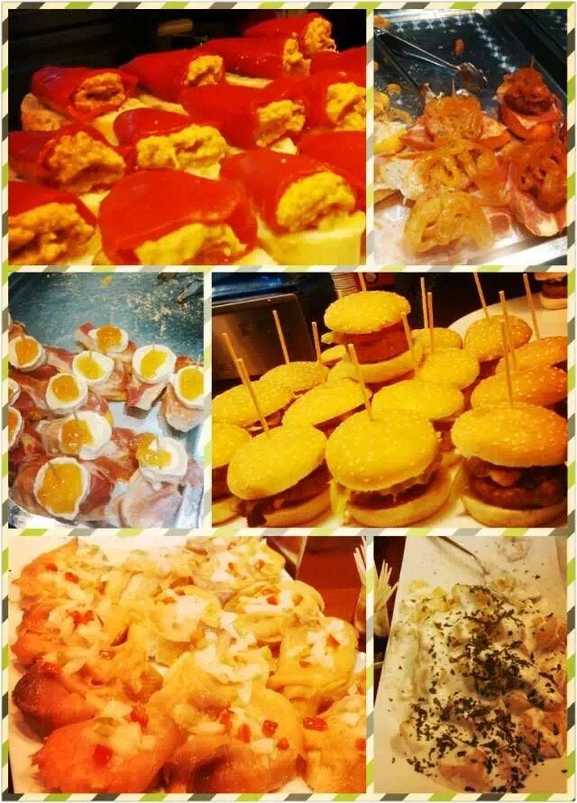
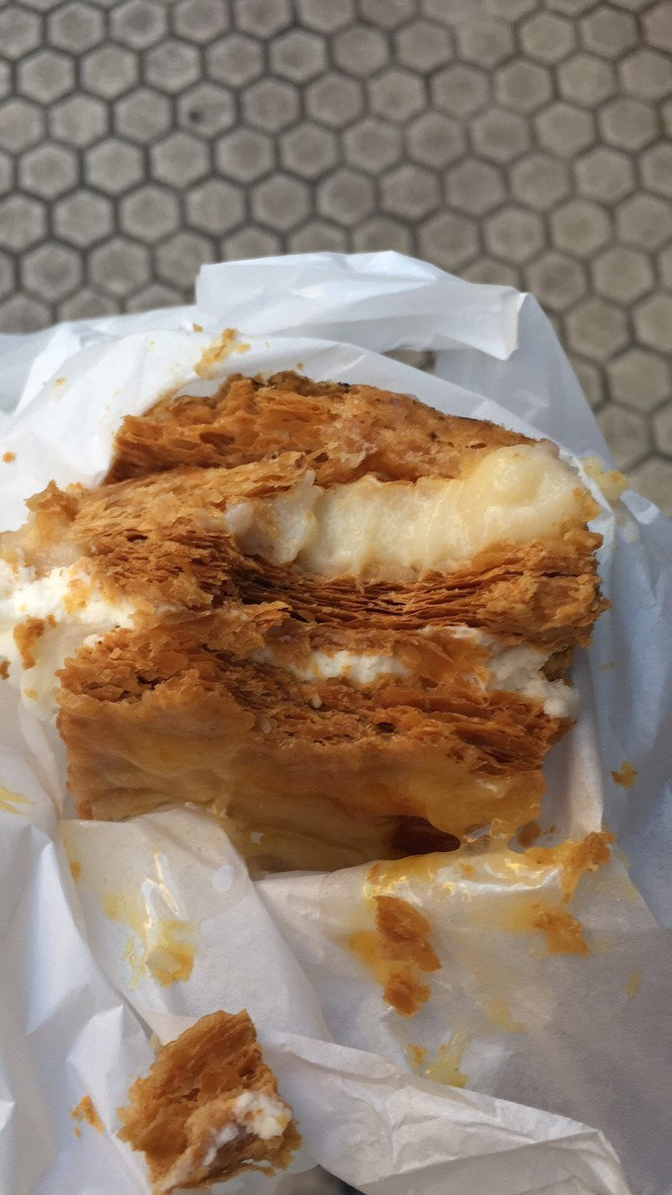
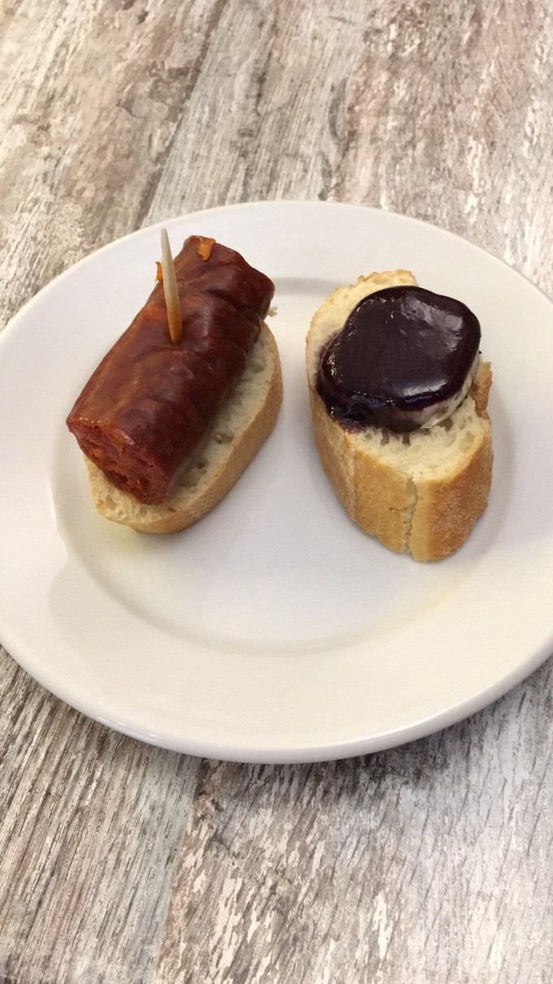
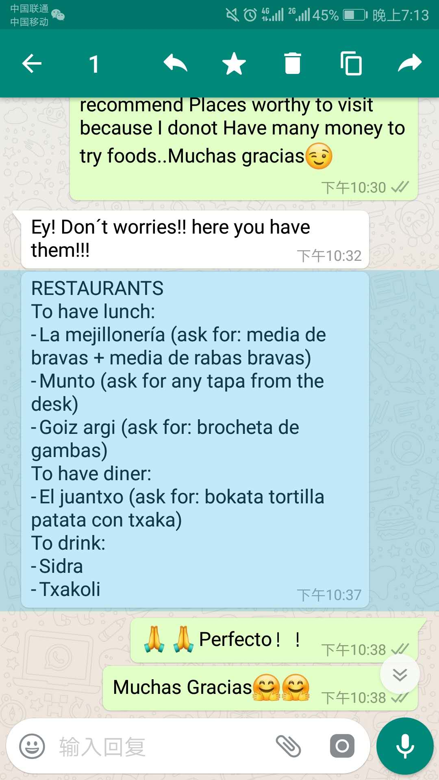
Snacks in 圣塞
Delicia
Pinchos
Pintxo(A cup of wine + a snack)(discount at Thursday)
Notes:
Delicia 1.95欧
Pinchos 1-2欧

Slide 10
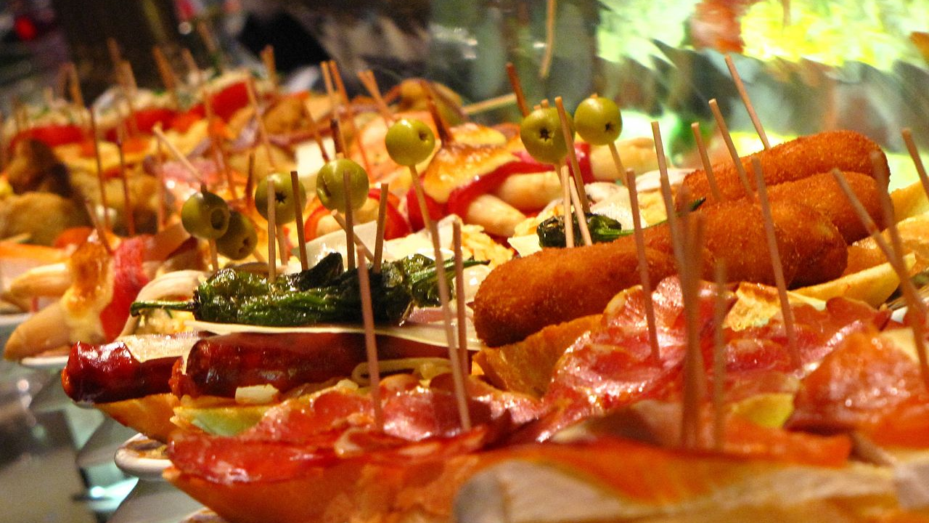
Tapas
Food Kind, Tapa or Tapas: appetizer(before lunch/dinner) or snack in Spanish cuisine
Cold such as mixed with olives and cheese
Hot such as chopitos which are battered, fried baby squid
Tapas variant: bocas(in Central American countries) or botanas(in Mexico)

Slide 11
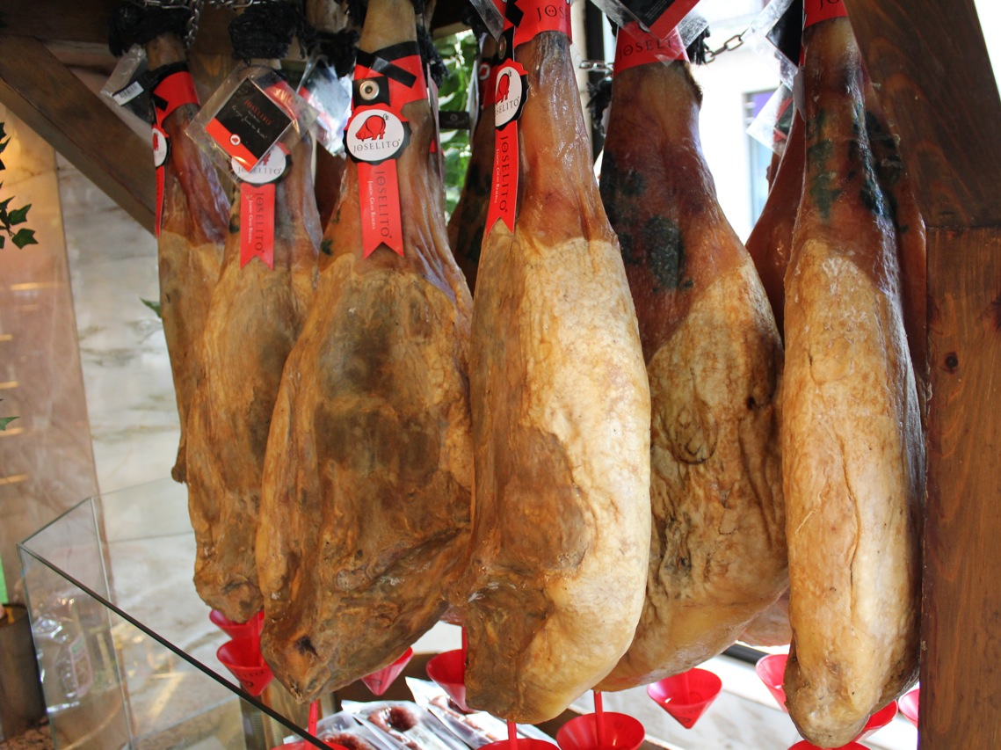
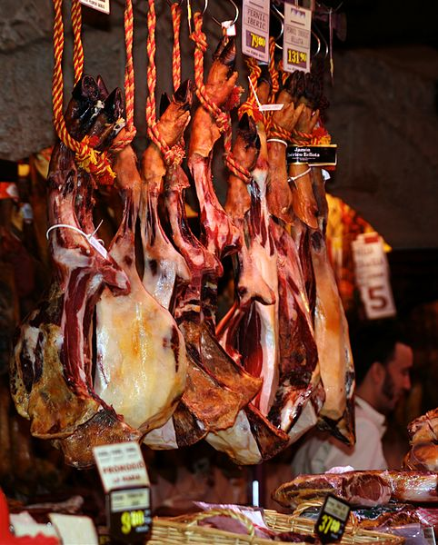
Jamon
Spanish word for ham. Dry-cured ham
1.Eat with Hami melon哈密瓜
2.Two types: Jamon iberico/ jamon serrano

Slide 12
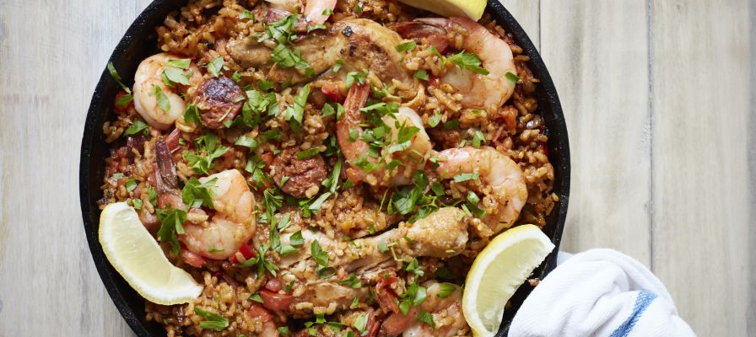
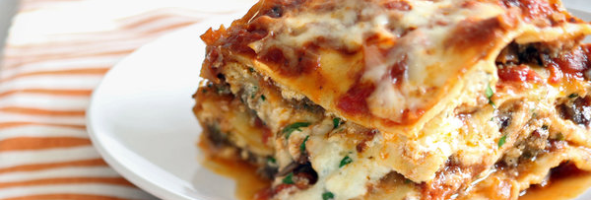
1.Spanish seafood Paella: Valencian rice dish, rice + soup + wine + indigents(rabbit, chicken, red gold-saffron), Paella is a kind of wok
2.Lasagna: wide, flat pasta, and possibly one of the oldest types of pasta. a dish made with several layers of lasagna sheets alternated with sauces and other ingredients, such as meats and cheese.
Notes:
Western food condiment: Basil, Rosemary, Passion fruit, coriander(芫荽/香菜), citrus fruit, artichoke(洋蓟), saffron, red pepper
Dancing bar
Discoteca: place for dancing, nightclub

Slide 13
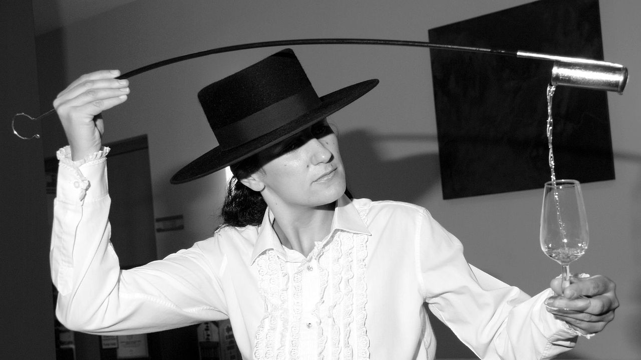
酒 Wine
Sherry
a fortified wine made from white grapes that are grown near the city of Jerez de la Frontera in Andalusia, Spain.
Venenciar: A venenciadora pours Sherry drawn from a cask (or "Venencia") into a catavino
Notes:
to pour sherry using a venencia

Slide 14
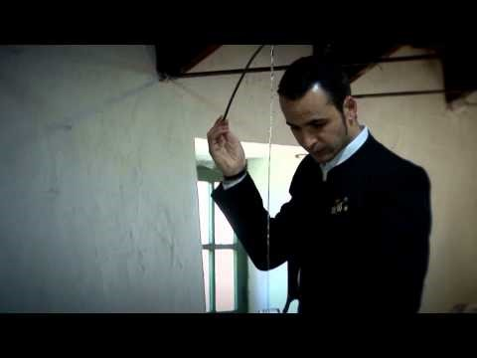
Jose Manuel Ruz Venenciador

Slide 15
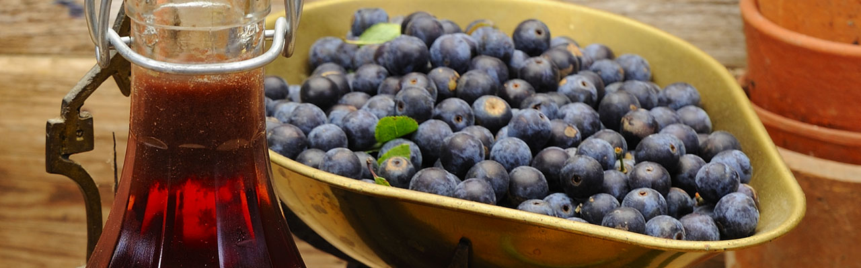
Wine 酒
1.jerez
2.Crianza/Reserva/Gran Reserva + Rioja/ Ribera de Duero
3.Orujo
4.Cava from Barcelona
5.Anis
6.Cider from Asturies
7.Patxaran from Navarra
8.Rum from Andalucía

Slide 16
Brand 品牌
ZARA
Mangle

Slide 17
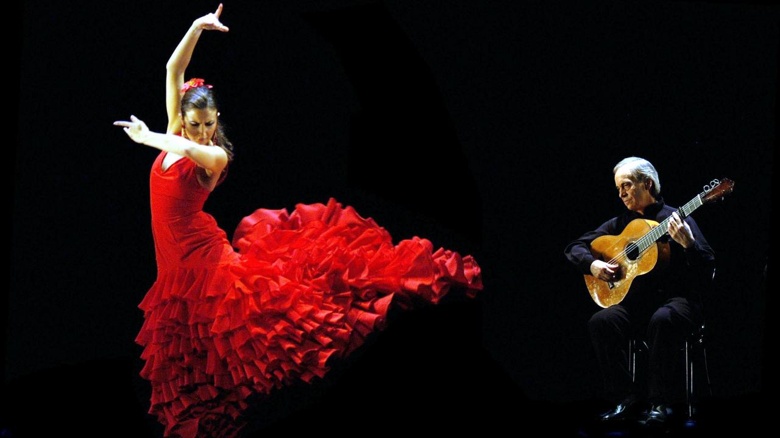
Flamenco
from Arabic:felagmengu meaning fugitive peasant
The musical traditions fused from Moors, Jews and gypsies in down-at-heel parts of town like Triana in Seville
Moors brought the guitar to Spain, Dramatic arm and hand movements, similar to Moorish dancing
Sing style is similar to wailing Arabic style
Singing and dancing in the bar
The music of the dispossessed

Slide 18
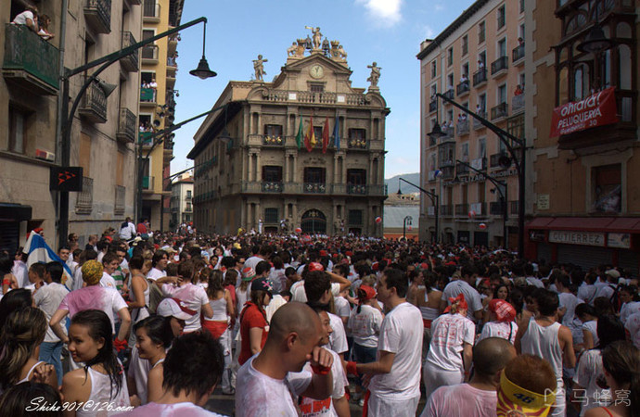
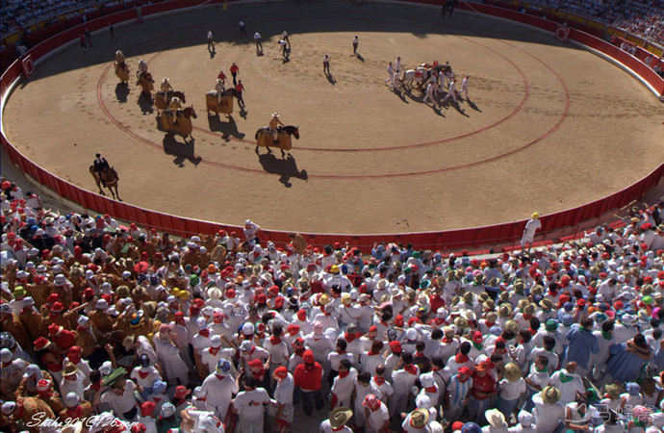
潘普洛纳斗牛场
地址：Navarra Pamplona, Navarra, Paseo de Hemingway
西班牙纳瓦拉大区首府潘普洛纳。目前用于斗牛。该斗牛场兴建于1922年，一共能容纳19529人，是西班牙第二大斗牛场。在圣费尔明节期间，这里是奔牛的终点。
附近景点
100米Monumento al Encierro
200米Teatro Gayarre
200米Palacio de Navarra

Slide 19
El Camino de Santiago
圣雅各之路或圣地牙哥朝圣之路（西班牙语：El Camino de Santiago）是前往天主教的圣地之一的西班牙北部城市圣地牙哥康波斯特拉的朝圣之路。主要指从法国各地经由比利牛斯山通往西班牙北部之道路，为联合国教科文组织登录的世界遗产，也是全世界仅有的两处“巡礼路”世界遗产
Notes:
https://flipermag.com/2017/04/19/camino-de-santiago/
http://bbs.qyer.com/thread-1083984-1.html
电影：朝圣之路 The Way

Slide 20
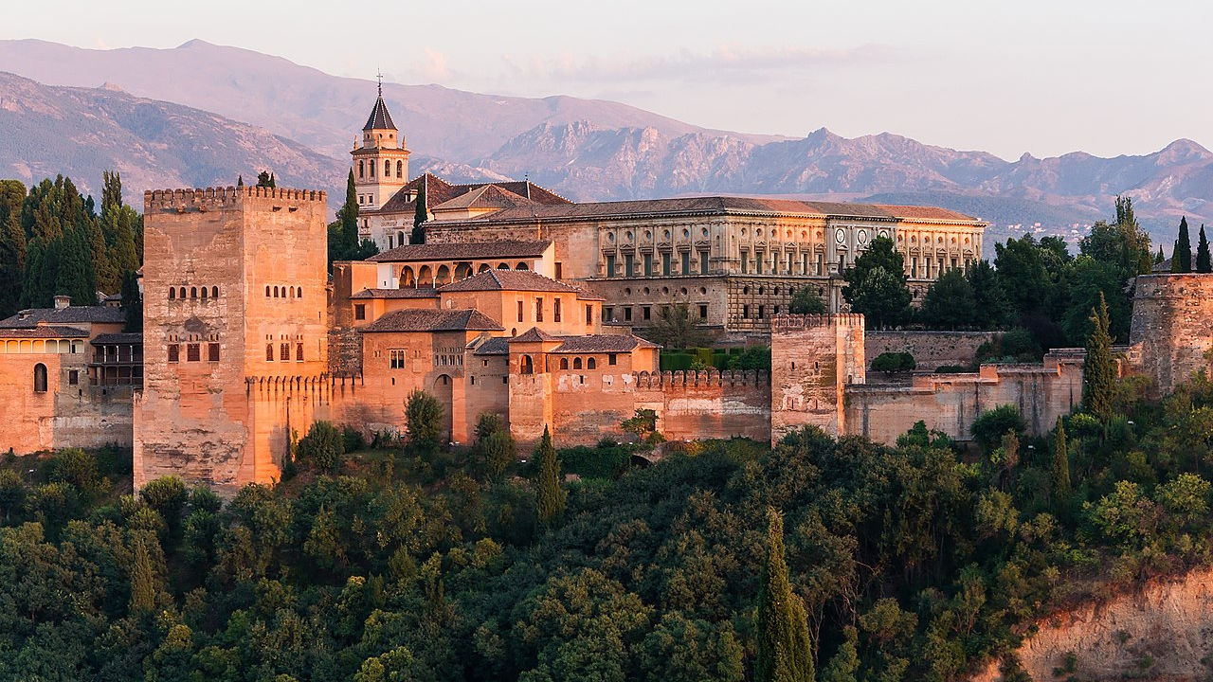
Granada
Last Moorish capital of Al Andalus(Nasrid dynasty) and last city to hold out the Reconquista(收复失地运动)
Arabic bath in Moorish bath houses
Moorish tea house to have tea
Moorish restaurant

Slide 21
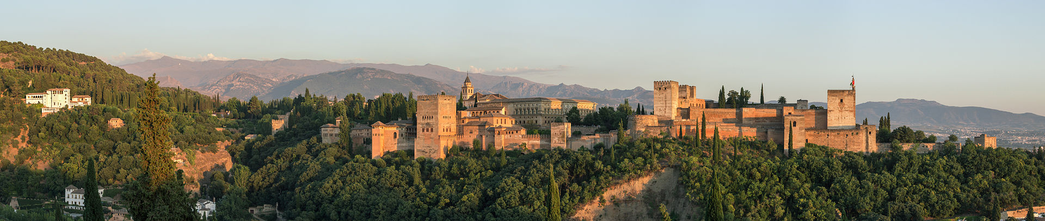
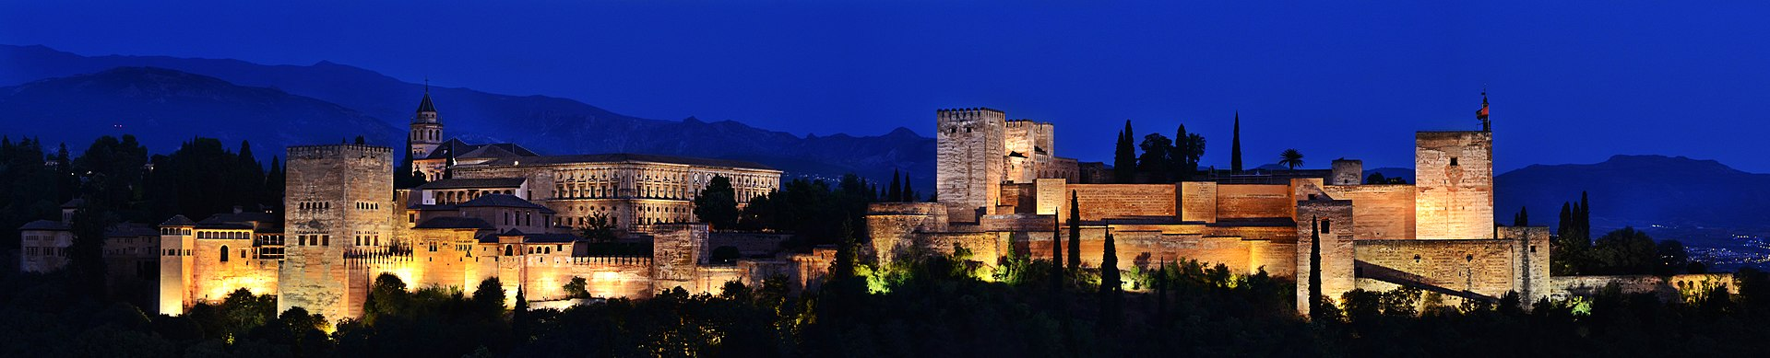
The Alhambra-Moorish Palace

Slide 22
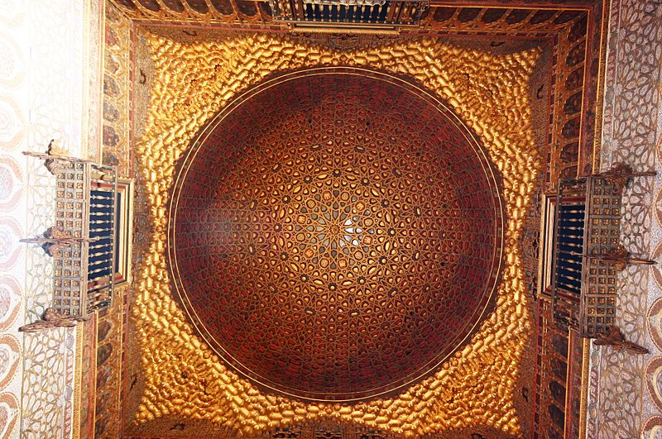
Hall of the Ambassadors
All about pattern and geometry
Contemplation and reflection
Bring people close to the God
Full of number seven and four
Seven: stages by which the soul ascend to God
Four: numbers of areas into which the vault of heaven could be divided
“There is no God but Allah. There is no conqueror but Allah”
Using water’s reflection, shifting and ephemeral to show the Islam’s tenet in architecture form that ”There is no God but God, there is no reality other than his higher reality. Everything people experienced in life is impermanent and insubstantial ”
https://evainmadrid.wordpress.com/2013/02/09/the-alhambras-hall-of-the-ambassadors/

Slide 23
Greetings
Muy Bueno: means very good
Lo siento: Sorry

Slide 24
People
Abd Al-Rahman-Creator of the Cordoba City
Nasrid Dynasty
Pedro the Cruel
Caliph of AI Andalus
Descendant of the great exile
Isabel I la Católica

